Slide 1
Greens Sector in Georgia.
Greens Value-Chain Study.
Giorgi Andguladze, Giorgi Teliashvili.
National Experts on Value-Chains.
May 2018 / Presentation of Research Results

Slide 2
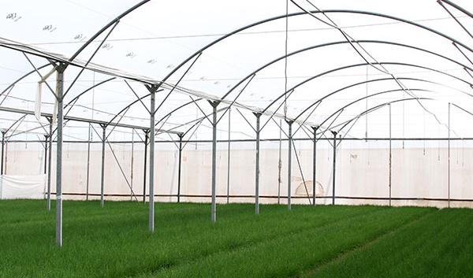
Content
Research Mission and Objectives
Methodology
Production and Greenhouse Types
Standards and Regulation
Packaging and Transportation
Funding
Value Chain Map
Export and Prices
Recommendations

Slide 3
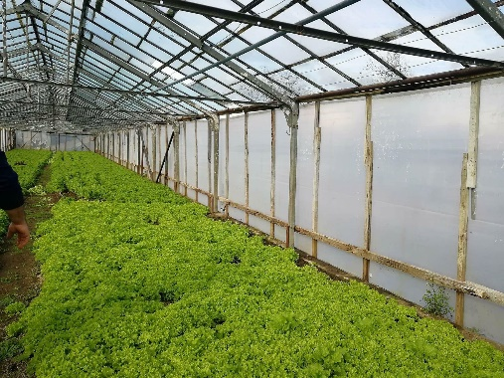
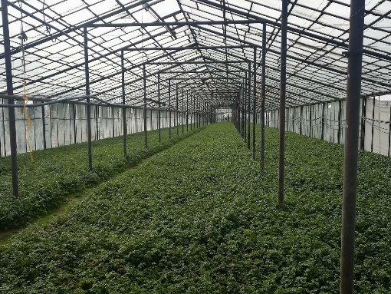
Main Mission of the Study
Main types of greens produced in Georgia are: fennel, parsley, coriander, scallion and celery.
Research objectives comprise:
Production practices in Georgia
Export Markets
Processes encompassing whole life cycle of greens along the value-chain
Problems along the value-chain
Research of Georgian greens sector:
Assessment of Competitiveness
Assessment of Sustainability

Slide 4
Methodology
Primary and Secondary Research Studies were conducted.
Secondary Research:
Geostat
World Bank
Eurostat
Research Papers
Trademap
Comtrade
Revenue Service
Studies conducted by the EU and other donors.
Primary Research: The research was conducted in Tskaltubo municipality of Imereti region. Small, medium and large size producers were targeted.
Interviews, discussions, questionnaires with:
Greenhouse owners/Cooperatives
Smallholders
Processors
Collectors
Exporters/Transporters

Slide 5
Value-Chain Research
For What?
Understanding the Structure of the Industry.
Market Specifications.
Main actors and leverage points along the chain.
Assessing financial condition of the smallholders involved in the chain.
Deducing problems and barriers along the value-chain.
Assessing investment opportunities.
Laying the groundwork for business-plan development.
We divide sectorial research into three steps:
1) Country-specific features: regulatory, economic, and trade policy in the country. Factor conditions - mix and cost of available factors, such as wage systems and rates, skill-set of available labour and existence of supplier of inputs/services with various levels of sophistication in the nation. On the demand side - differing segment structures of home demand.
2) General sector-specific features: trade indicators, prices, competitors, value-chain structure, global enabling environment, finance and supporting sectors.
3) Business-specific features: Intricacies and specificities of production and processing practices. Other actors involved in the chain. Financial and economic variables.

Slide 6
Value-Chain Research
SFVC (Sustainable Food Value Chain): Focusing on Environmental, Social and Economic Sustainability.
Supporting Sectors (Indirect Horizontal):
Governmental Policy
Grants and Funding
International Organizations
Donors
Human Resource Availability
R&D and Innovation
Marketing
Suppliers
Primary-Production
Processing & Packaging
Sales and Distribution
Raw Materials
Component Parts
Processing & Packaging
Retail
Wholesale
Upstream Industries Midstream Industries Downstream Industries

Slide 7
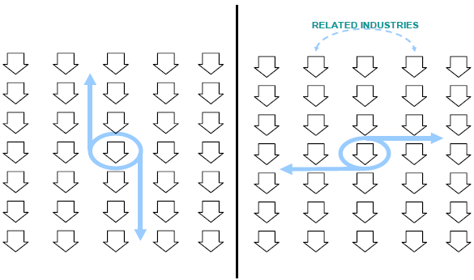
Value-Chain Research
Indirect Horizontal: Supporting Industries which create the environment in which a value-chain operates.
Indirect Horizontal: Direct competitors that operate on the same stage of a value-chain and in the same industry.
Vertical: Different industries connected to each other through commercial exchanges and representing each other’s suppliers and clients.
The Same Industries

Slide 8
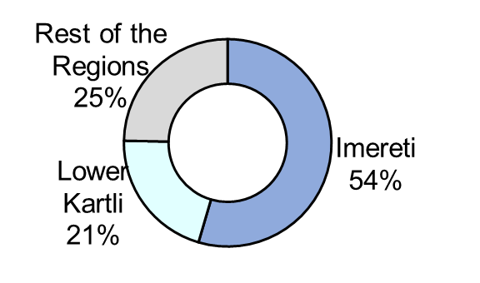
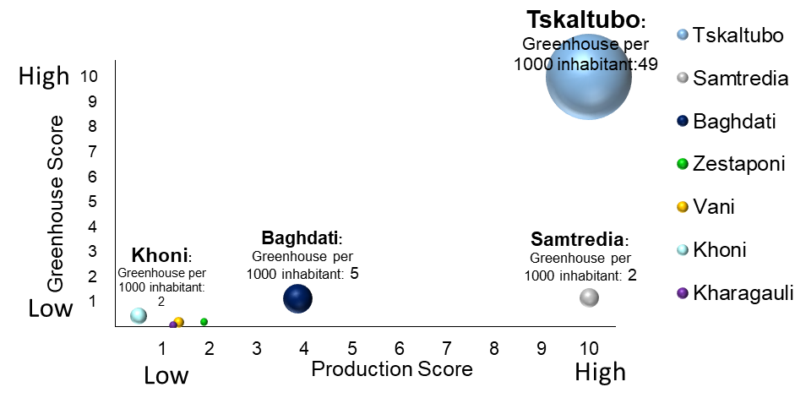
Greens Production
Production, Imports and Exports
Regional Distribution of Production
Geographic Cluster Analysis in Imereti
Greenhouses in Imereti

Slide 9
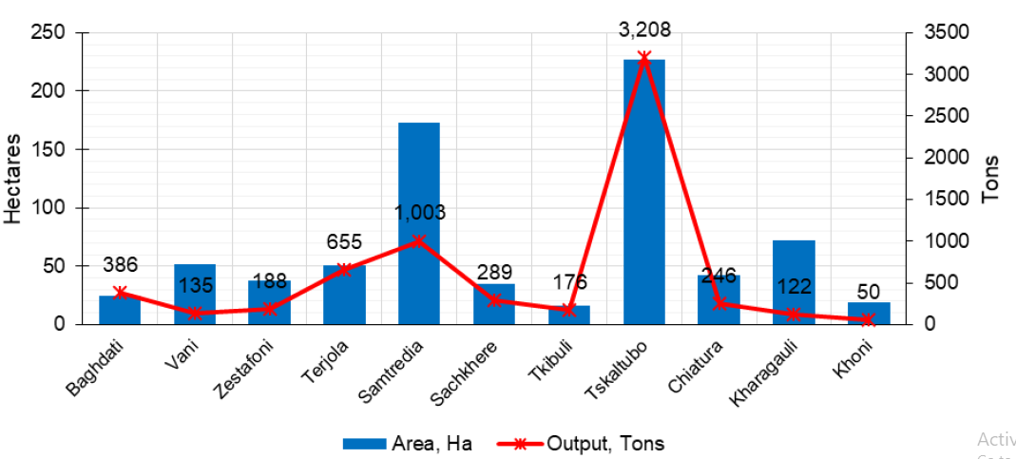
Production
There were 3,100 greenhouses in Imereti in 2016. Out of this 2,774 greenhouses were in Tskaltubo municipality.
Greens Production in Imereti

Slide 10
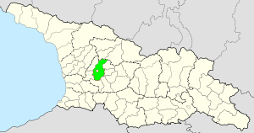
Production in Tskaltubo
Tskaltubo: Ideal climactic conditions for greens production.
Temperature in Winter is ideal for greens production.
Post-harvest life of greens: Under 0 degrees condition it is 2 to 3 weeks.

Slide 11
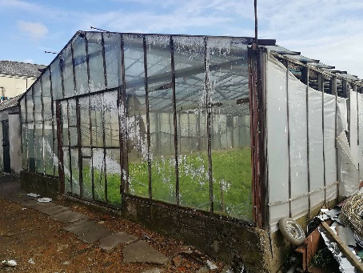
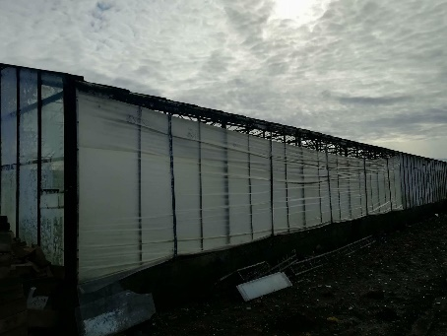
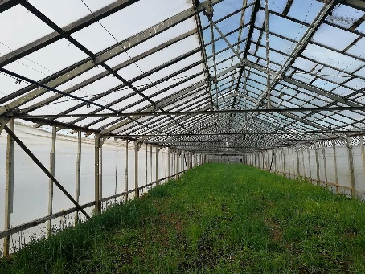
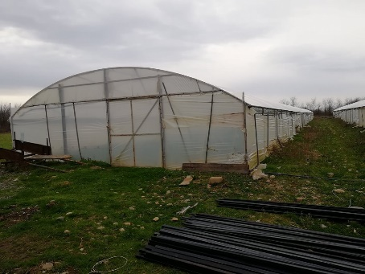
Greenhouses
Types of Greenhouses:
Mainly with plastic cellophanes.
Some greenhouses are made of glass.
Some are build with wood.
On average 500 m2.
Drip irrigation systems deriving water from rivers or underground wells using generators as a source.
Drainage and ventilation systems are not present.
No heating available.

Slide 12
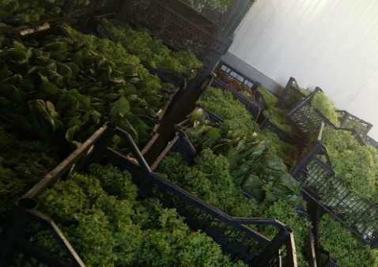
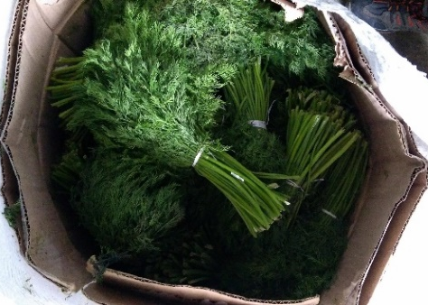
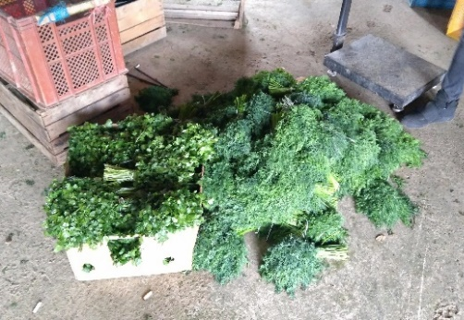
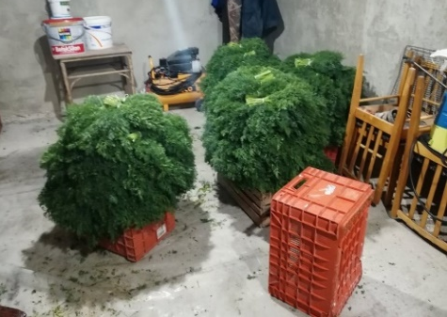
Greenhouses
Cultural Practices:
Planted in September-October.
Seeds imported from Italy, Netherlands, Russia and some are local (Prices vary from15 GEL to 350 GEL/kg).
Laboratory for soil analysis – in Tbilisi, Kutaisi and Gurian region.
Vegetation period is from 1.5 to 2 months – Harvesting about 8 times a season (from November to May)
Hired labor – harvests about 30 kg a day and is paid 15 – 20 GEL/day.

Slide 13
Standards
National Food Agency (NFA) is responsible for compliance with standards.
Good Agriculture Practice (GAP) Certificate: for high-value European markets.
For exporting to the EU member states:
Undergo customs and phytosanitary inspections at the point of entry into the EU (border).
Be imported into the EU by an importer registered in the official register of an EU country.
Be announced before arrival to the customs office at the point of entry.
Documentation Needed for Exports:
Certificate of origin of goods: Issued by Georgian chamber of commerce and costs about 100 GEL.
Phytosanitary certificate: Issued by National Food Agency of Ministry of Agriculture of Georgia and costs from 50 – 100 GEL.
Document from a laboratory: Document confirming laboratorial analysis of greens and a plant-health certificate.
GlobalGap: GlobalGap certificate.
Technical documentation: An invoice from the buyer and a document specifying details of what is being exported.

Slide 14
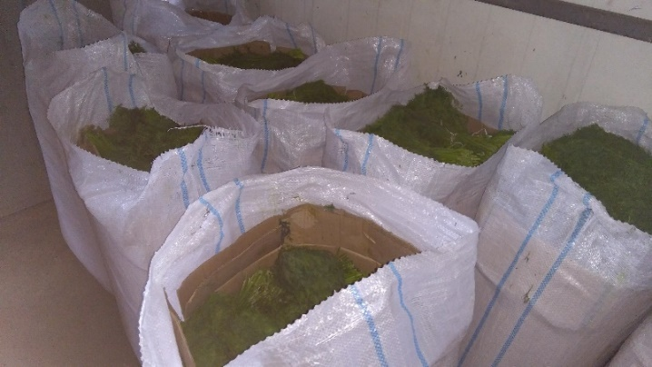
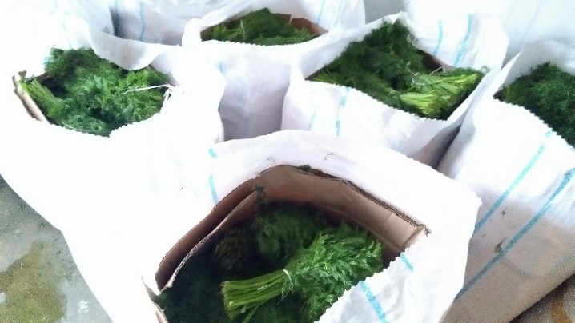
Packaging and Transportation
Packaging: Frequently stored in carton boxes, jute sacs, tied with rubber bands.
Capacity: 30 kg.
Exporters: Put blocks of ice inside carton boxes.
Transportation: Transporting with trucks. Some with refrigerated trucks + blocks of ice.

Slide 15
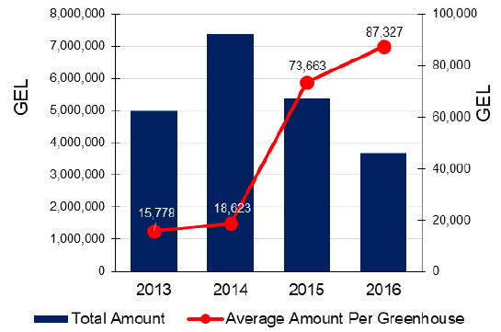
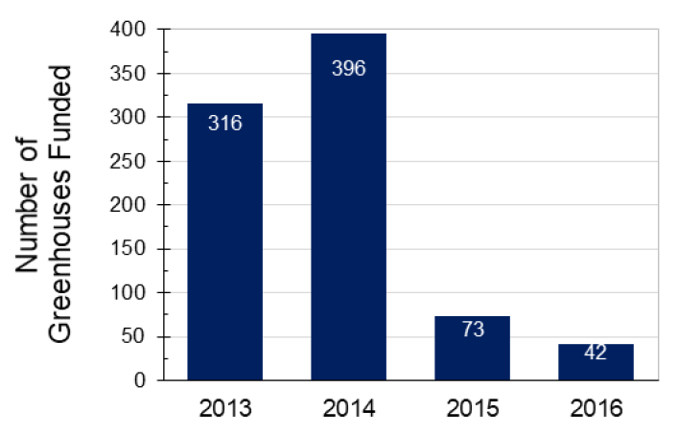
Governmental Policy
Funding: Preferential Agro Credit Project - NNLE Agricultural Projects Management Agency .
Preferential Agro Credit Project in Imereti
Preferential Agro Credit Project in Imereti

Slide 16
Preferential Agro Credit Project
Frequency Distribution (2013)
Frequency Distribution (2014)
# of Greenhouses Funded
Frequency Distribution (2015)
Frequency Distribution (2016)
# of Greenhouses Funded

Slide 17
Prices
Retail price index of greens in 2018

Slide 18
Price
Approximate average prices of greens (unprocessed) in 2018
N | Georgian Greens |  | Units |  | Cost | Farm-Gate Price | Wholesale Price | Retail Price
1 | Average Price&Cost |  | GEL/kg |  | 1.54 | 2.00 | 3.4 | 4.45
Margins (Under Normal Conditions)
N | Georgian Greens | Units |  | Farm-level |  | Wholesale | Retail
1 | Mark-up | GEL/kg |  | 0.5 |  | 1.4 | 1.05
2 | Margin | % |  | 32.5% |  | 70% | 30%

Slide 19
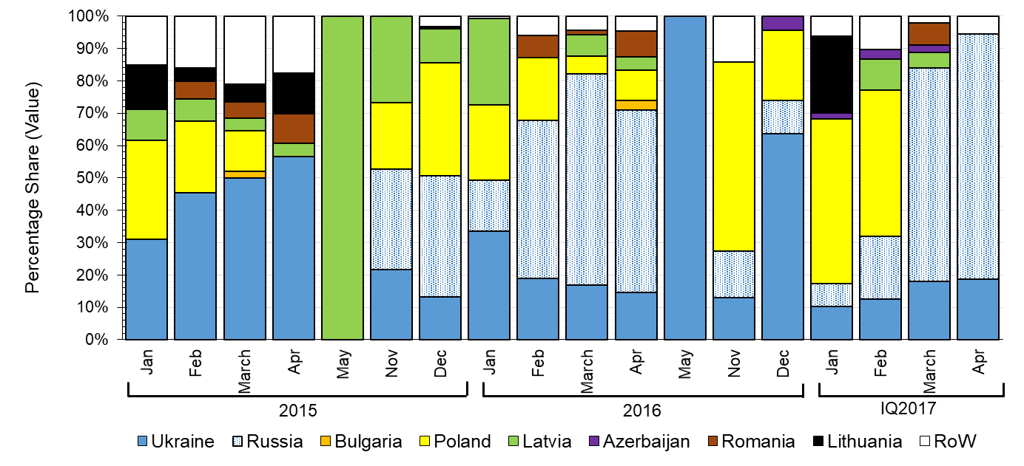
Exports
Exports of Georgian Fennel (By months and countries)

Slide 20
Exports
Export of Georgian Fennel by Countries

Slide 21
Exports
Exports of Georgian Fennel

Slide 22
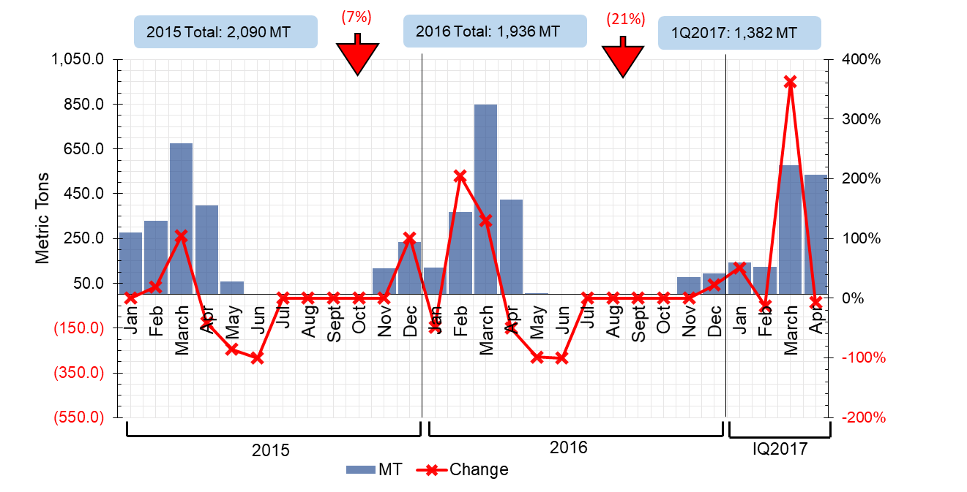
Exports
Exports of Georgian Fennel

Slide 23
Exports
Problems with exporting to the EU: It is needed to…
Process the greens.
Package the greens.
Meet minimum volume requirements.
Establish connections with importers/distributors.
Meet standard requirements.
Need for Certification:
Certificate of origin of goods: Issued by Georgian chamber of commerce and costs about 100 GEL.
Phytosanitary certificate: Issued by National Food Agency of Ministry of Agriculture of Georgia and costs from 50 – 100 GEL.
Document from a laboratory: Document confirming laboratorial analysis of greens and a plant-health certificate.
GlobalGap: GlobalGap certificate.
Technical documentation: An invoice from the buyer and a document specifying details of what is being exported

Slide 24
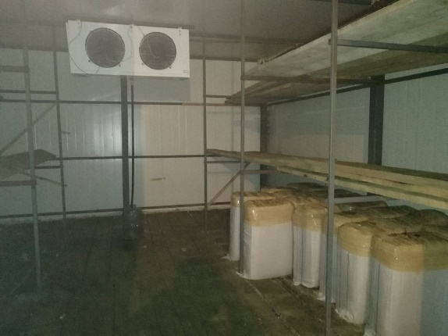
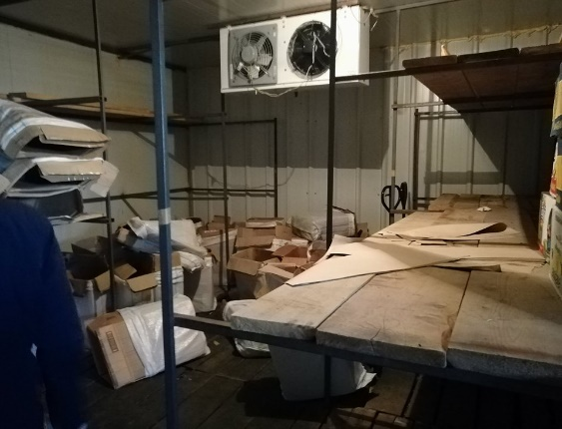
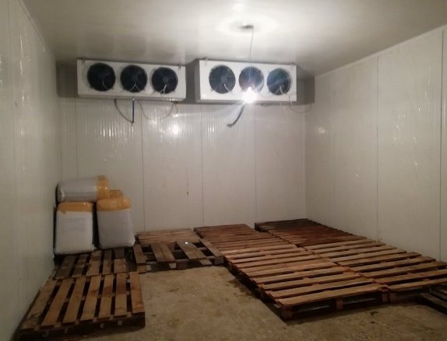
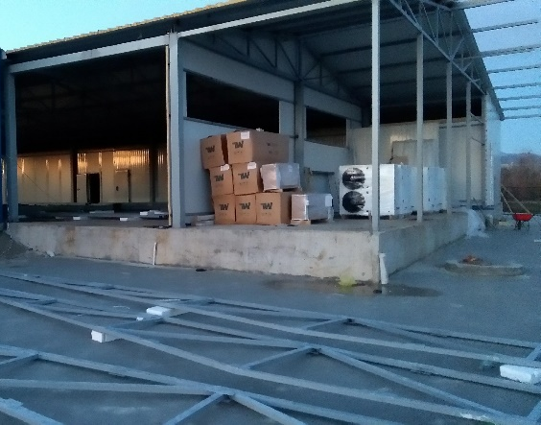
Supply-Chain
Greenhouses: Smallholders throughout Imereti. 3,100 greenhouses in 2016.
Cold-Storage: Cold storages funded by donors. Greens stored mostly under minus 2 degrees Celsius before they are exported.
Collectors: Collecting greens from smallholders and selling on open-air bazars, markets and supermarkets.
Exporters: Collecting greens, transporting to the border and selling to foreign importers.
Processors: Purchase greens, process them, package and sell them to supermarkets or to exporters.
Retail: Open air-bazaars, stalls, shop counters, supermarkets.

Slide 25
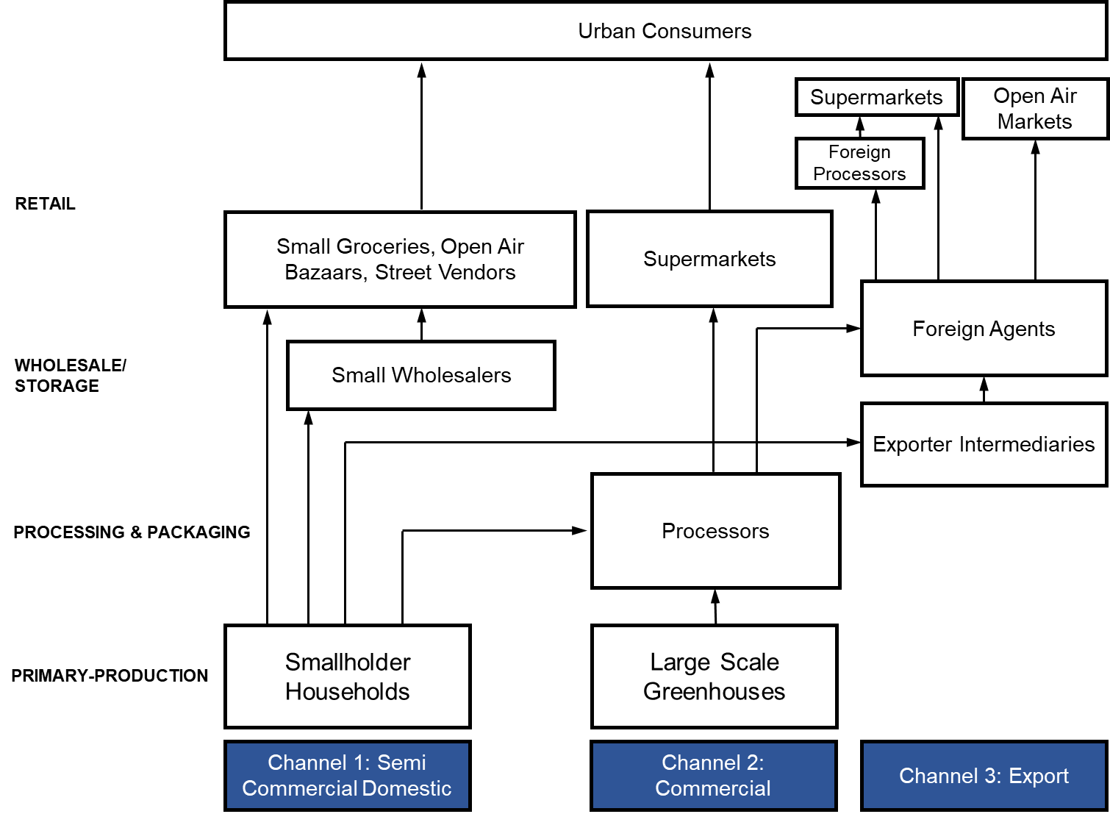
Value-Chain Map

Slide 26
Assessment of Sustainability
Current State of Georgian Greens Sectors can be Evaluated as Significantly UNSUSTAINABLE.
Unstable Prices: Fierce competition on an international arena, climactic conditions and variations in yields leads to highly fluctuating prices.
Insufficient Revenues: During warm winters revenues plummet for smallholders.
Investment: Investment is dependent upon grants, donors and governmental support.
Losses: During warm winters large amounts of unsold greens are thrown away.
Underutilized Storage: Cold storage facilities are largely underutilized.
Seasonality: No exports of Georgian greens in Summer.
Exports: Dependency on post-soviet markets.
Added Value: The current value-chain mostly supplies to low-value end-markets, such as open air-bazars, shop counters or post-soviet markets, so value addition in Georgia is limited.
Note: Not enough margin to meet the standards and supply high value markets.

Slide 27
Exports During Summer
Average Fennel Imports During Summer Months (2015 – 2016)
Possible Share of Summer Imports that Georgia Could Take
N | Importing Country | 2015-2016 (Tons)
1 | France | 6,952
2 | Germany | 981
3 | Britain | 1,933
4 | Netherlands | 188
5 | Romania | 43
6 | Poland | 164
7 | Lithuania | 97
8 | Latvia | 45
9 | Total | 10,401
N | Possible Share of Total Imports | Tons
1 | 1.0% | 104
2 | 1.3% | 135
3 | 1.5% | 156
4 | 2.0% | 208
5 | 2.3% | 239
6 | 2.5% | 260
7 | 3.0% | 312

Slide 28
Exporting in Summer
Additional Land Needed for the Production of Fennel to be Exported in Summer
E.g. to produce 300 tons of greens for exporting in Summer 8 ha of additional land will be necessary (considering yield will reach 40 ton/ha)
In 2016 748 ha of land was used for greens production in Imereti.
Possible Production (tons)

Slide 29
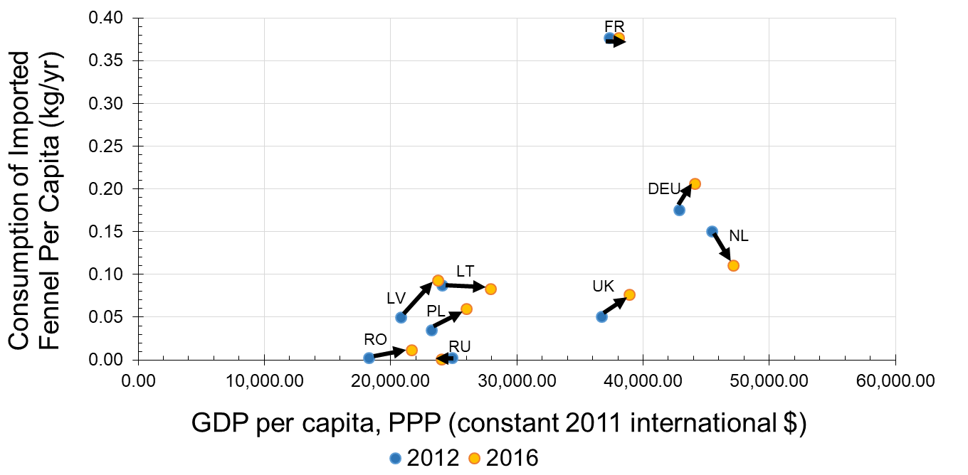
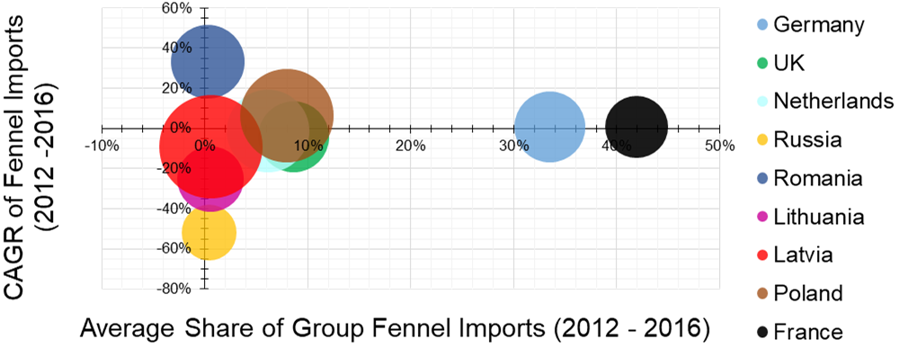
Export Markets
Which are the most attractive EU markets for Georgian greens producers?
Evaluation of Export Markets
Lithuania
Latvia
Romania
Bulgaria
Poland
Germany
Why?

Slide 30
Export Markets
Average Yield Rates Compared to EU Member States
Lithuania Latvia Bulgaria Poland Germany Romania

Slide 31
Consolidation Center
Consolidating Smallholders: Training greenhouse owners on GlobalGAP practices and standards.
Supply: Bringing smallholders under one umbrella and homogenizing + stabilizing produce.
Post-harvest techniques: Training smallholders on post-harvest techniques especially during hot summer months.
Purchasing Greens: Greens should be purchased from smallholders for at least 2.00 ₾/kg.
Necessary post-harvest techniques:
Harvesting and fieldwork should be directed to protecting the harvest from the sun and overheating.
Pre-cooling of greens after harvest (Vacuum Cooling is recommended).
Processing and packaging with ventilated plastic and carton boxes.
Refrigerated storage at +1 Degree Celsius.
Refrigerated transportation at +1 Degree Celsius.
Loading and unloading areas that provide cool conditions for greens.

Slide 32
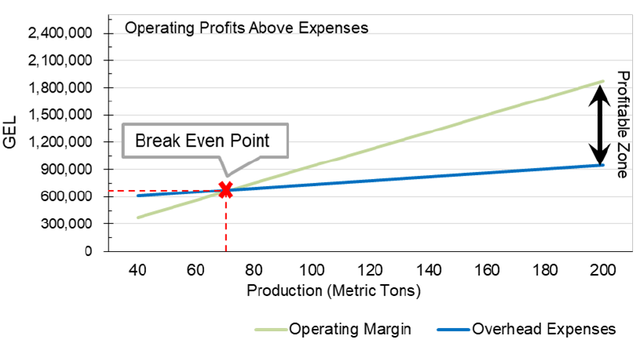
Consolidation Centre
Scale of a Consolidation Center:
In case of right cultural practices greenhouse owners can achieve an yield rate of 40 tons/ha.
It is recommended to operate the consolidation center at a minimum turnover of 70-80 tons a year to break-even. Minimum export price of 15 GEL/kg.
Operating profits above overhead/administrative costs

Slide 33
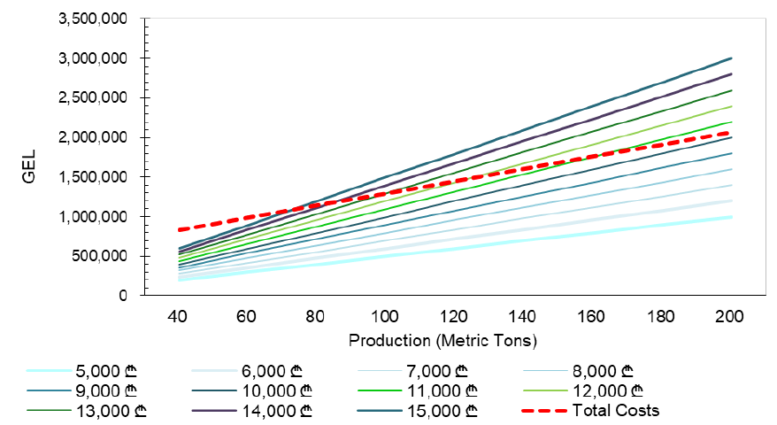
Consolidation Centre
Revenues above total costs at varying production scales and prices
Possible Unit Price Variations (₾/ton)

Slide 34
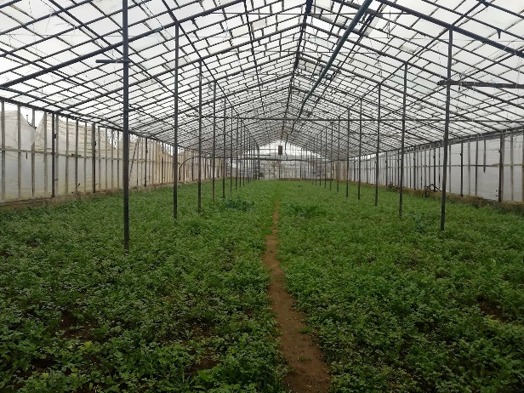
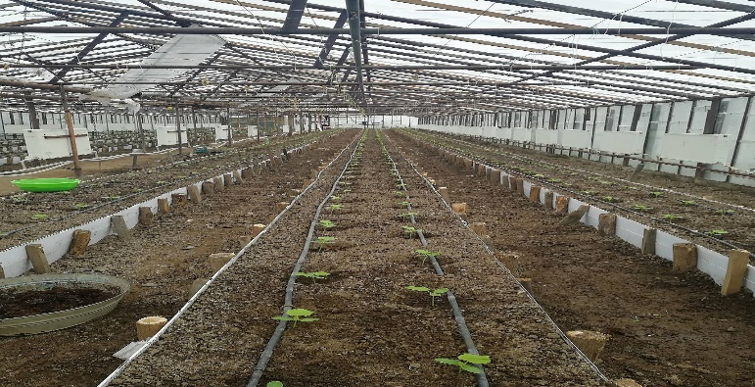
GlobalGAP Certification
GlobalGAP Certificate: Comprises guidelines of practical standards.
Starting from before the plant is in the ground (seed and nursery control points)
Harvest Operations
Non-processed end product (Produce Handling control points)
A system of monitoring will need to be established to monitor the practices of smallholders involved in the chain.
Certifying Bodies (CBs): Issue GlobalGAP Certificates.
A document will have to be developed outlining GlobalGAP standards and practical guidelines – Involving all smallholders and employees of the center.
As of now, Herbia is the only processor in Georgia that holds GlobalGAP certificate.

Slide 35
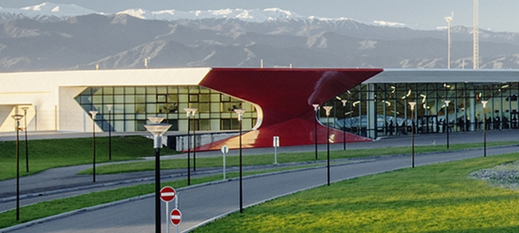
Air Transportation
Kutaisi Airport: Currently does not handle cargo transportation and does not have cargo terminals.
Is close to Tskaltubo.
Air transportation will extend post-distribution life of Georgian greens to 2 - 3 weeks if proper cold-chain is established.
Although, transportation cost will increase significantly.
We estimate that transportation cost could go up on average by more than 1.2 GEL to 1.65 GEL per kilogram shipped by air – compared to road and marine transportation.

